Slide 1
Newton’s Divided Difference And Lagrange's inverse interpolation Formula
Course Instructor
Engr. Rahemeen
Rahemeen.bukc@bahria.edu.pk

Slide 2

Newton Divided Difference
Forward
Interpolation is an estimation of a value within two known values in a sequence of values.
Newton’s divided difference interpolation formula is an interpolation technique used when the interval difference is not the same for all sequences values. Suppose f(x₀), f(x₁), f(x₂)………f(x_{n}) be the (n+1) values of the function y=f(x) corresponding to the arguments x=x₀, x₁, x₂…x_{n}, where interval differences are not same
Then the first divided difference is given by:
Time complexity: O(n2)

Slide 3
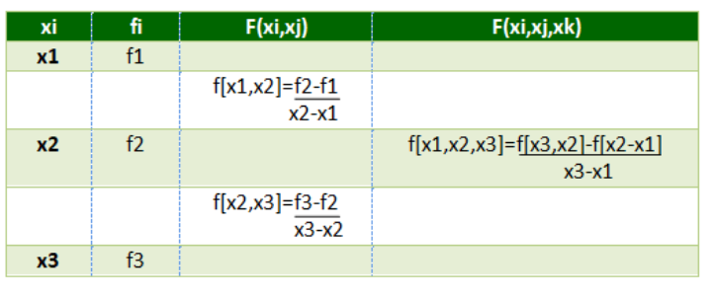
Newton Divided Difference Table

Slide 4
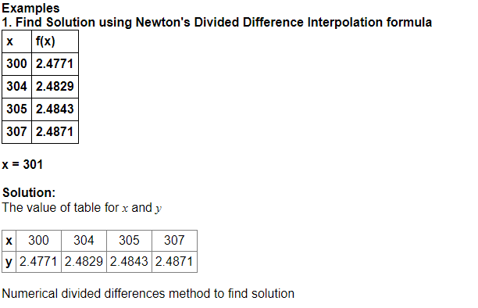
Example 1

Slide 5
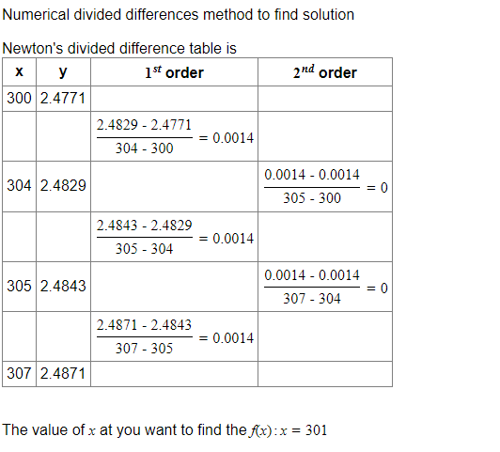

Slide 6
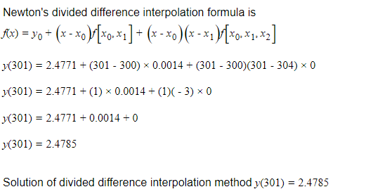

Slide 7
Lagrange’s Inverse Interpolation
Inverse Interpolation on the other hand will help you find the values of 'x' from know values of 'y’.
This is often used to check whether the correctness of output y for an unknown function f i.e how much argument x for this output y differs from the original input.
The problem of inverse interpolation can be solved using Lagrange’s Formula. Lagrange’s Formula:
The formula for inverse interpolation is similar to the interpolation formula but few changes.

Slide 8
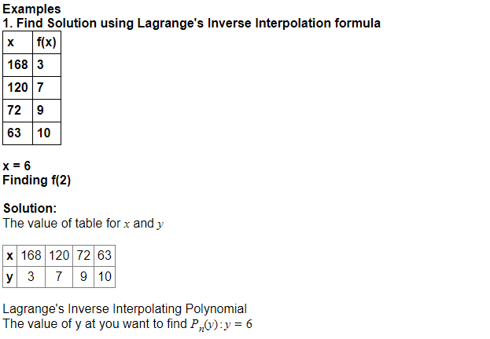

Slide 9
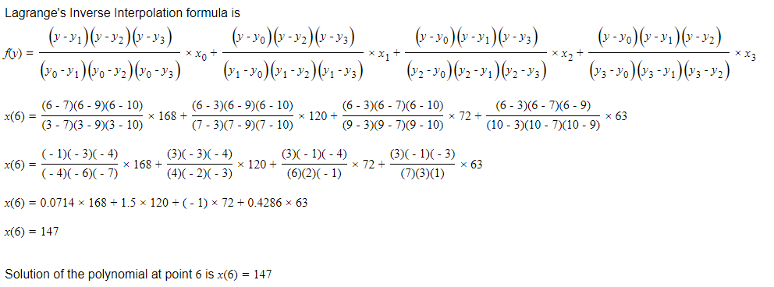

Slide 10
Exercises
Find the annual premium at the age of 33 from a table and construct a difference table and interpolate the value of f(x) :
The following table represents the time t and the corresponding velocity v of a particle moving with non-uniform velocity.
From this table determine the time when the velocity of the particle becomes 2.75.
x | 4 | 5 | 7 | 10 | 11 | 13
y | 48 | 100 | 294 | 900 | 1210 | 2028
t | 0.0 | 1.0 | 1.5 | 2.0
u | 2.5 | 3.8 | 4.6 | 5.3

